Slide 1
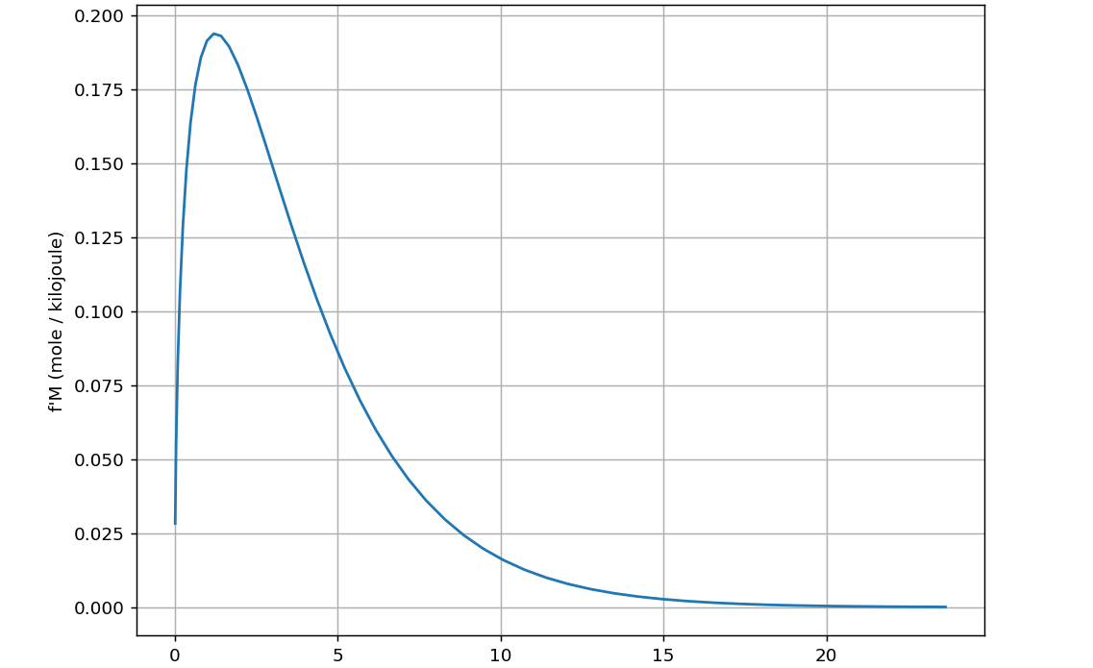
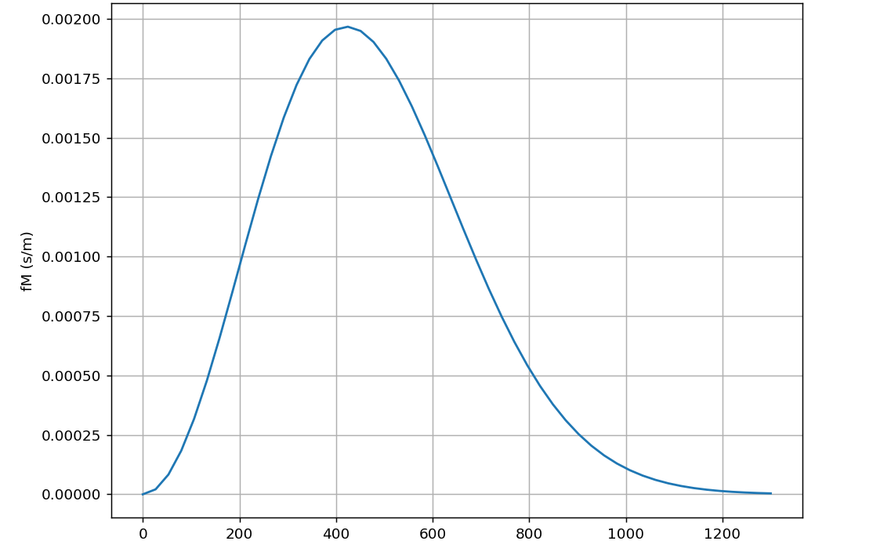





Transforming from one probability density to another
OK … what if we wanted to think about all this in terms of kinetic energy instead of speed?
New: Energy probability density
Old: Speed probability density
$f_{M}\left(T,v\right)$
${f′}_{M}\left(T,ε\right)$
$$ε$$
$$v$$
We’re going to insist that ${f′}_{M}$gives the same probability as $f_{M}\left(T,v\right)$:
$${f′}_{M}\left(T,ε\right)∆ε=f_{M}\left(T,v\right)∆v$$

Slide 2

Transforming from one probability density to another
OK … what if we wanted to think about all this in terms of kinetic energy instead of speed?
New: Energy probability density
Old: Speed probability density
$f_{M}\left(T,v\right)$
${f′}_{M}\left(T,ε\right)$
$$∆v$$
$$ε$$
$$v$$
We’re going to insist that ${f′}_{M}$gives the same probability as $f_{M}\left(T,v\right)$:
$${f′}_{M}\left(T,ε\right)∆ε=f_{M}\left(T,v\right)∆v$$

Slide 3
Transforming from one probability density to another
OK … what if we wanted to think about all this in terms of kinetic energy instead of speed?
New: Energy probability density
Old: Speed probability density
$f_{M}\left(T,v\right)$
${f′}_{M}\left(T,ε\right)$
$$∆v$$
$$∆ε$$
$$ε$$
$$v$$
We’re going to insist that ${f′}_{M}$gives the same probability as $f_{M}\left(T,v\right)$:
$${f′}_{M}\left(T,ε\right)∆ε=f_{M}\left(T,v\right)∆v$$

Slide 4
Transforming from one probability density to another
OK … what if we wanted to think about all this in terms of kinetic energy instead of speed?
New: Energy probability density
Old: Speed probability density
$f_{M}\left(T,v\right)$
${f′}_{M}\left(T,ε\right)$
$$∆v$$
$$∆ε$$
$$ε$$
$$v$$
That means ${f′}_{M}\left(T,ε\right)=f_{M}\left(T,v\right)$ $\frac{∆v}{∆ε}$ (where $ε=\frac{1}{2}Mv^{2}$ gets us $\frac{dv}{dε}$)

Slide 5
Blackboard work: find the expression for ${f′}_{M}\left(T,ε\right)$
OK … what if we wanted to think about all this in terms of kinetic energy instead of speed?
New: Energy probability density
Old: Speed probability density
$f_{M}\left(T,v\right)$
${f′}_{M}\left(T,ε\right)$
$$∆v$$
$$∆ε$$
$$ε$$
$$v$$
That means ${f′}_{M}\left(T,ε\right)=f_{M}\left(T,v\right)$ $\frac{∆v}{∆ε}$ (where $ε=\frac{1}{2}Mv^{2}$ gets us $\frac{dv}{dε}$)

Slide 6
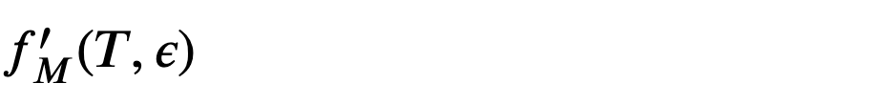
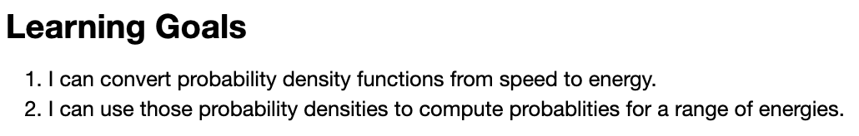
You’ll also implement this in Python

